Slide 1
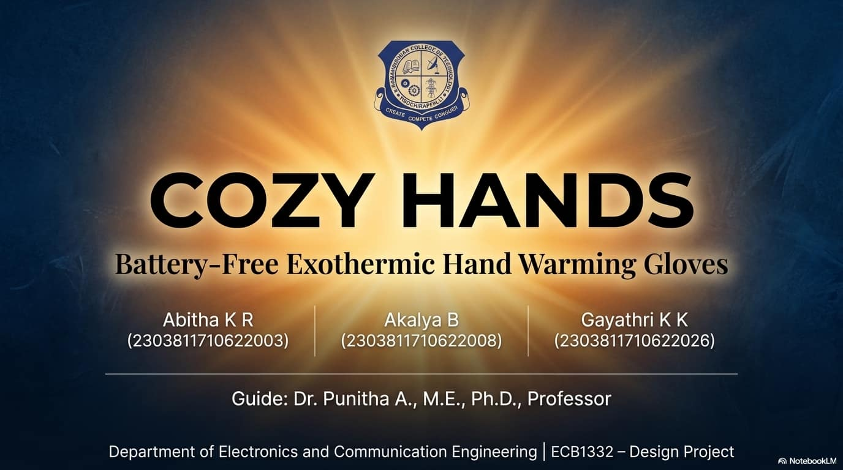

Slide 2
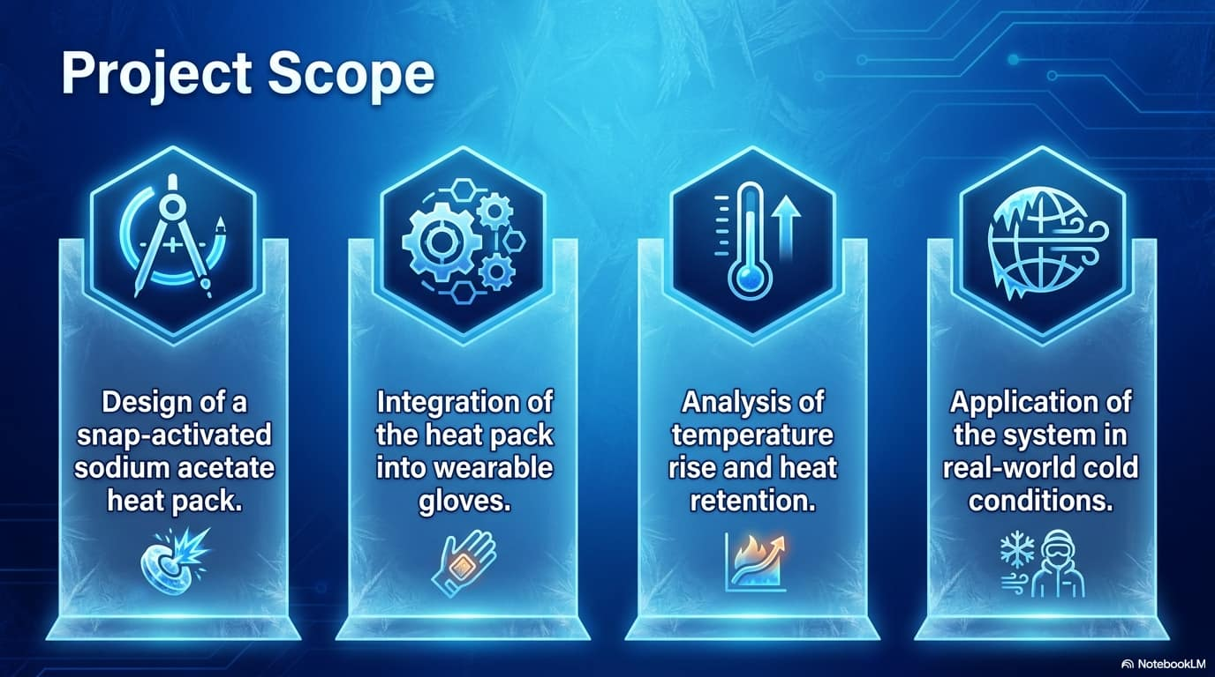

Slide 3
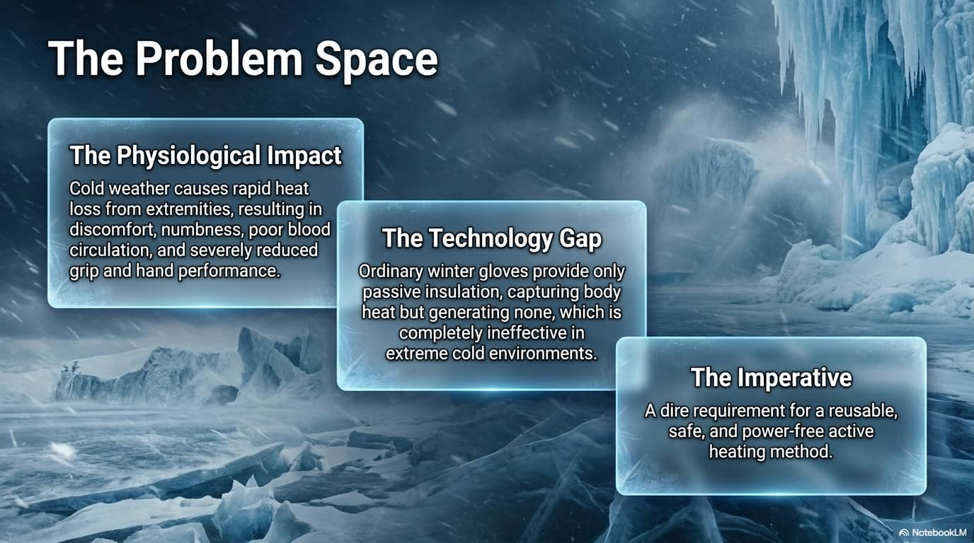

Slide 4
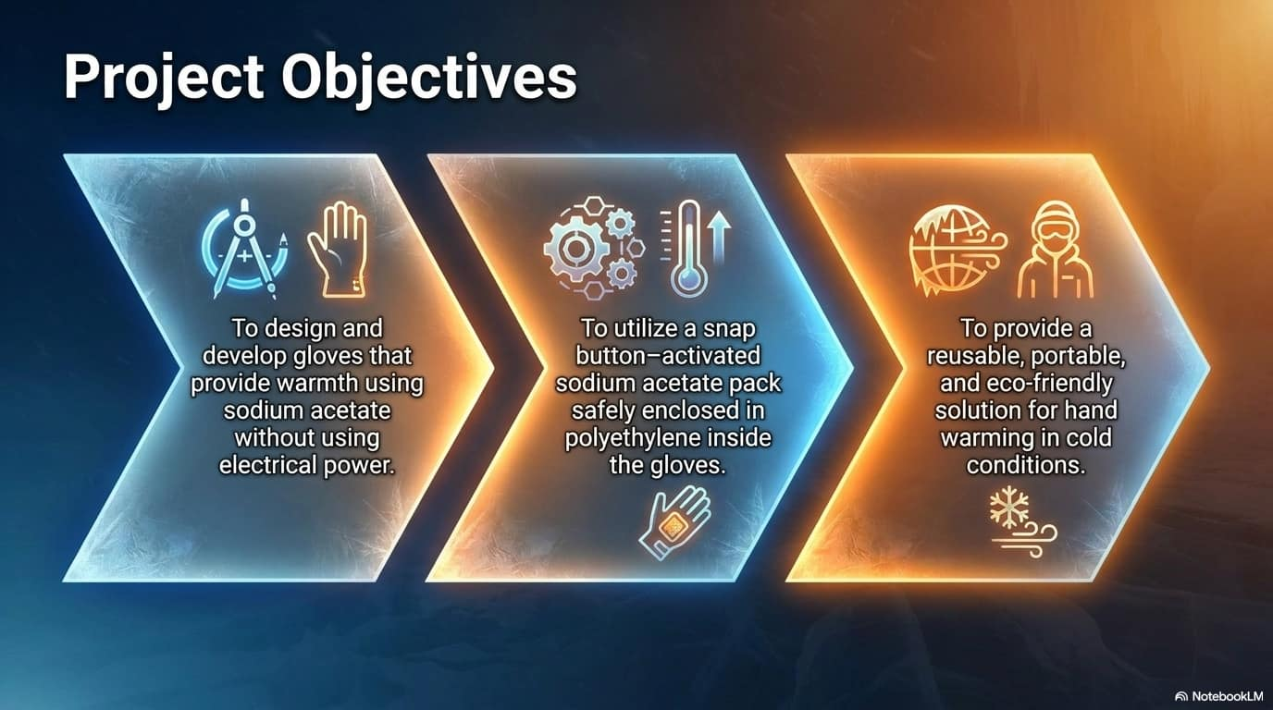

Slide 5
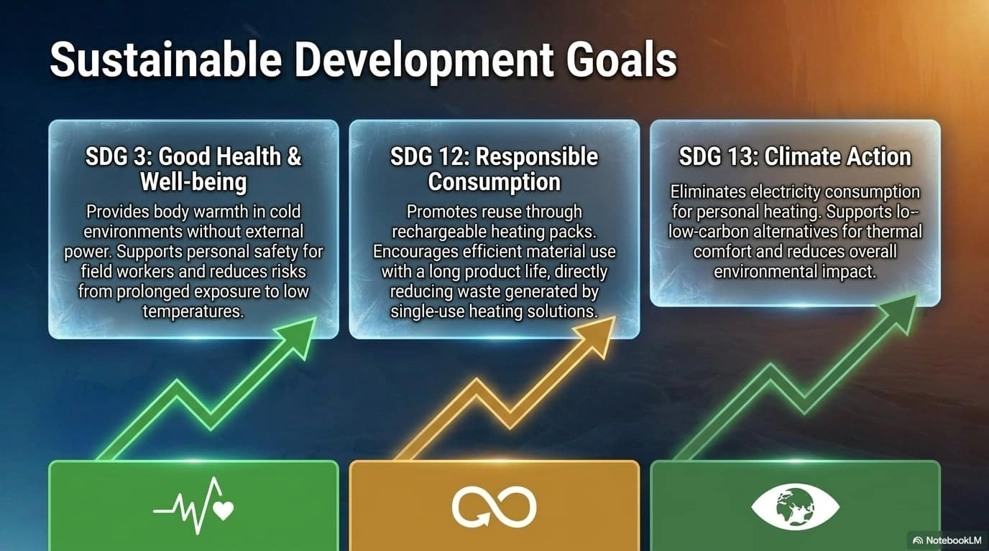

Slide 6

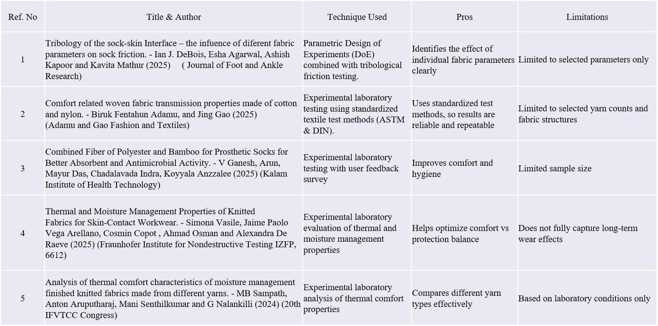
LITERATURE SURVEY

Slide 7
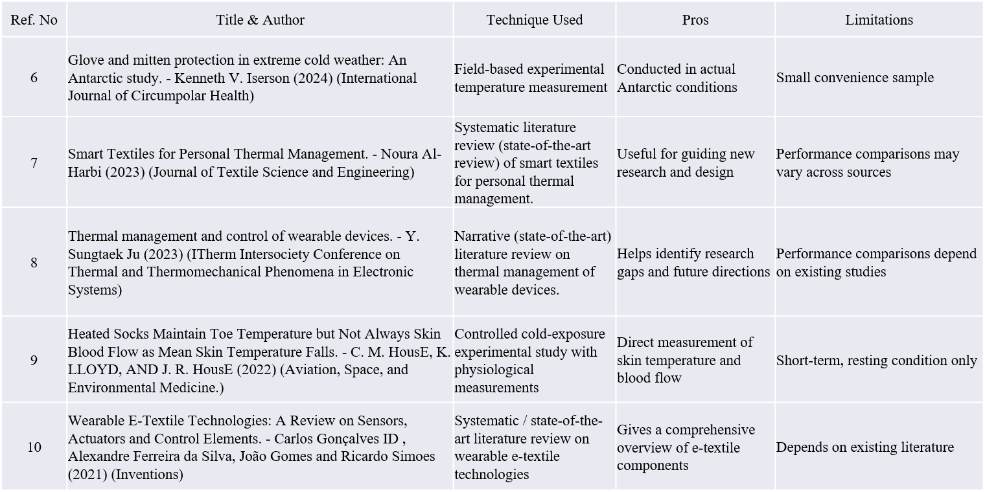
LITERATURE SURVEY

Slide 8
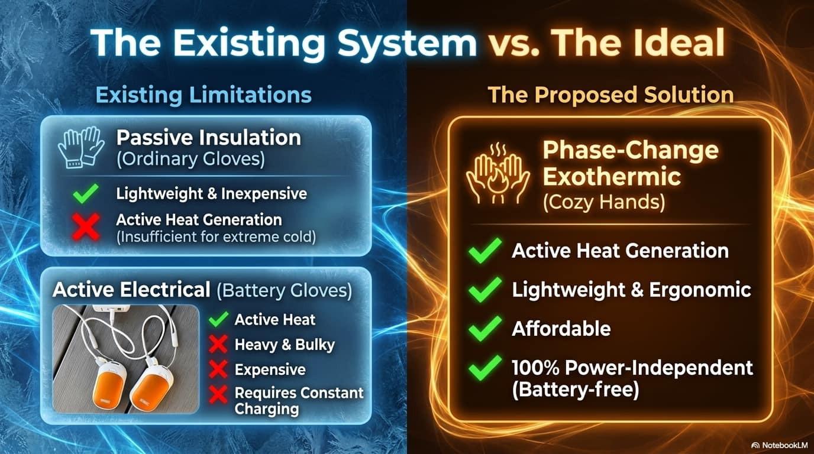

Slide 9
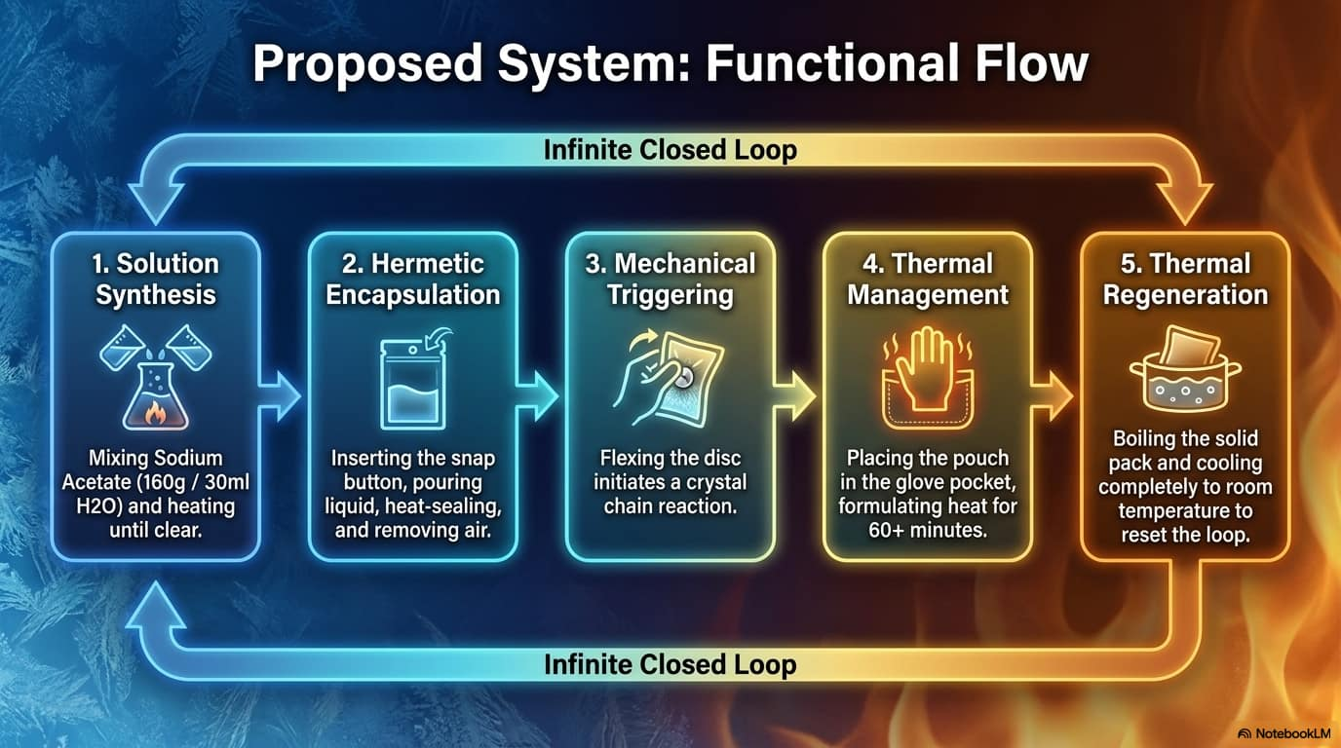

Slide 10
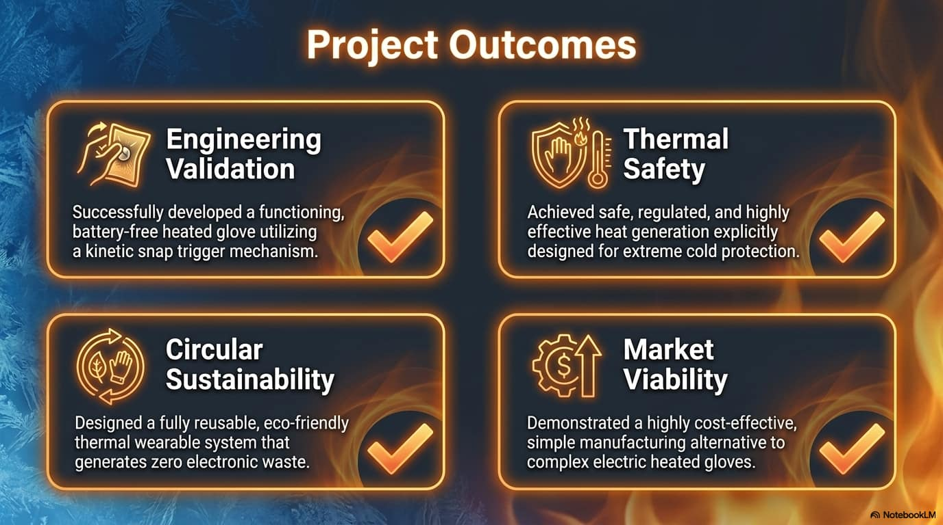

Slide 11
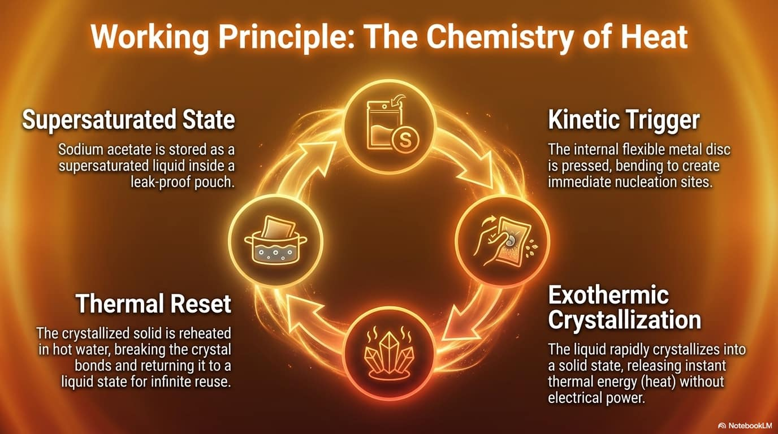

Slide 12
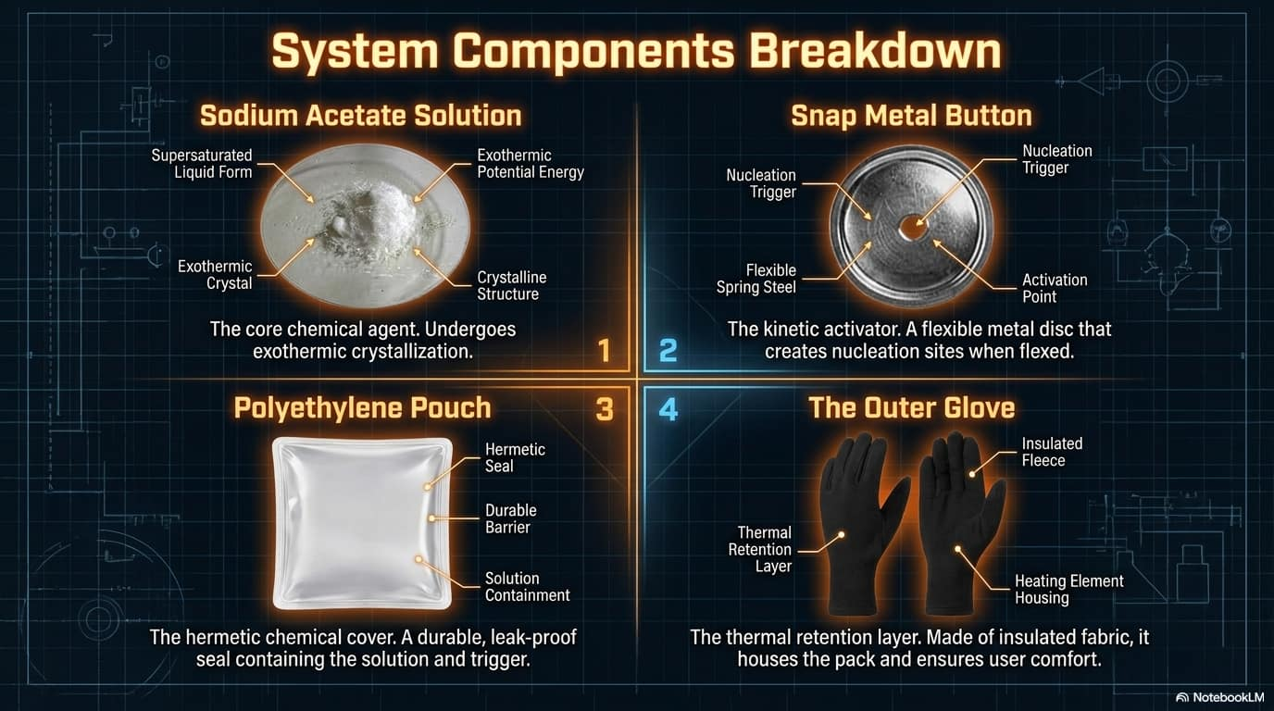

Slide 13
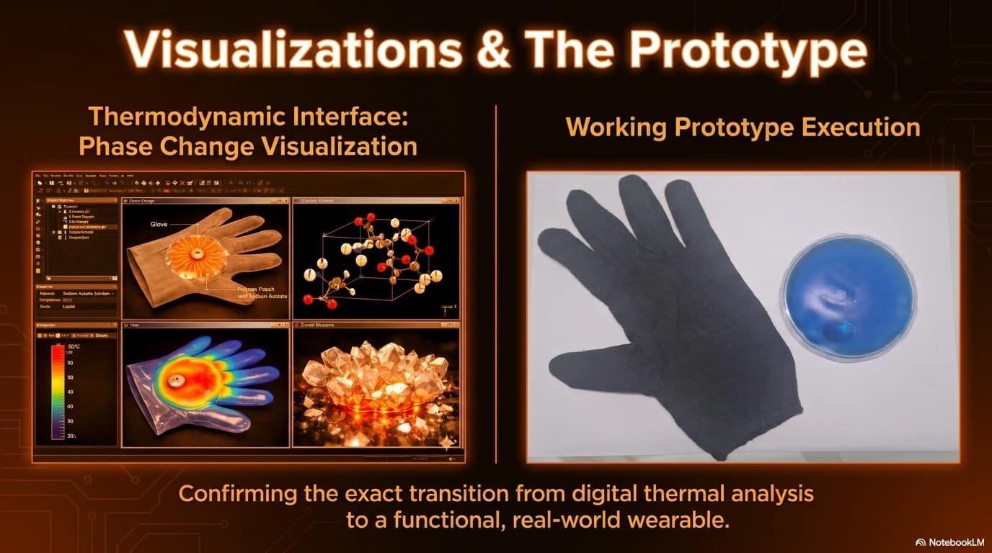

Slide 14
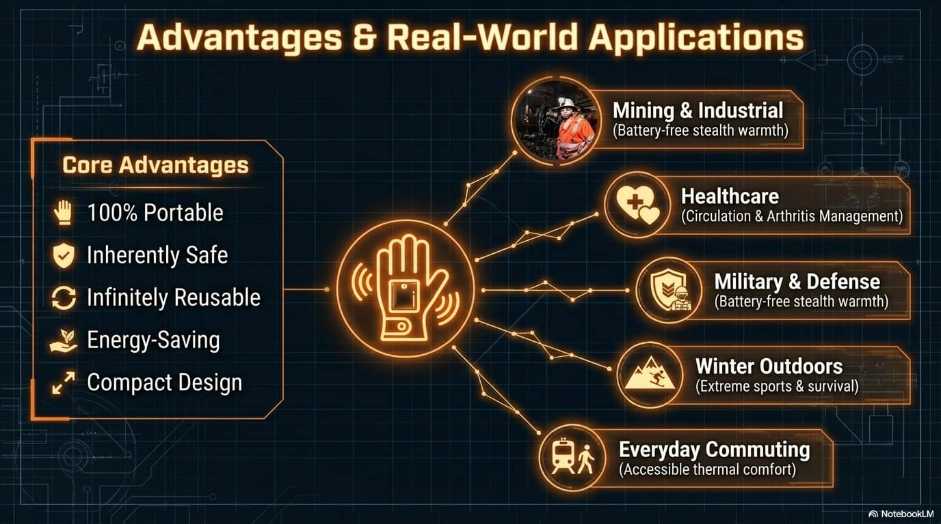

Slide 15
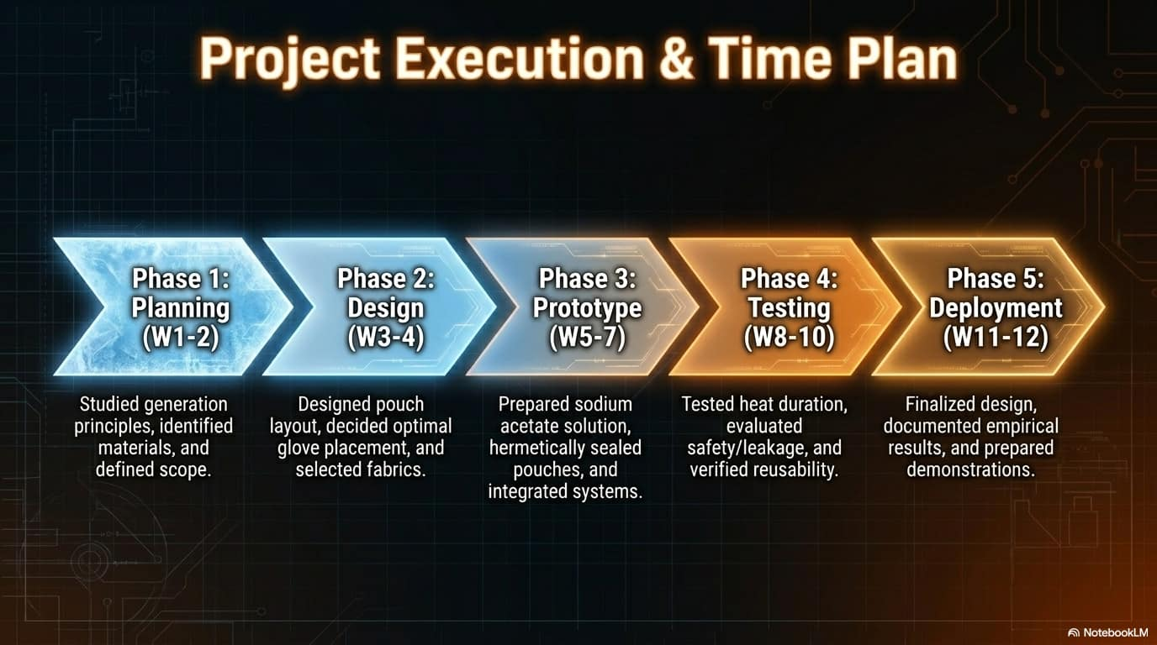

Slide 16

REFERENCES
1. Agyenim, F., Hewitt, N., Eames, P., and Smyth, M., “A Review of Materials, Heat
Transfer and Phase Change Problem Formulation for Latent Heat Thermal Energy
Storage Systems,” Renewable and Sustainable Energy Reviews, vol. 14, no. 2, pp.
615–628, 2010.
2. Castellani, J., and Young, T., “Human Physiological Responses to Cold Exposure:
Acute Responses and Acclimatization to Prolonged Exposure,” Comprehensive
Physiology, vol. 6, no. 1, pp. 443–469, 2016.
3. Cho, G., “Smart Clothing: Technology and Applications,” CRC Press, vol.8, no. 4,
pp. 433–479, 2009.
4. Daanen, D. A., “Finger Cold-Induced Vasodilation: A Review,” European Journal of
Applied Physiology, vol. 89, no. 5, pp. 411–426, 2003.
5. Farid, M. M., Khudhair, A. M., Razack, S. A. K., and Al-Hallaj, S., “A Review on
Phase Change Energy Storage: Materials and Applications,” Energy Conversion and
Management, vol. 45, no. 9–10, pp. 1597–1615, 2004.

Slide 17
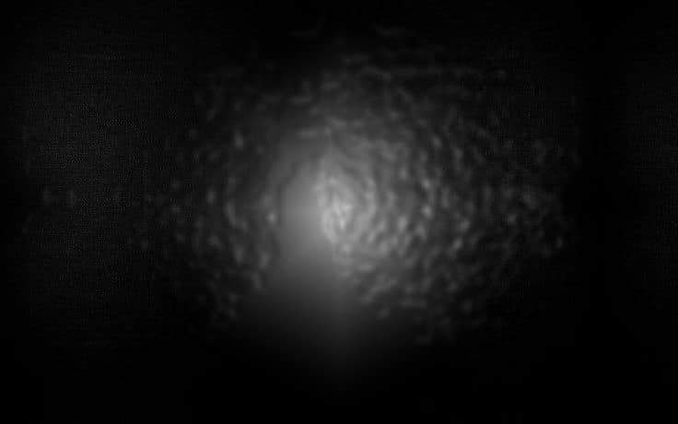
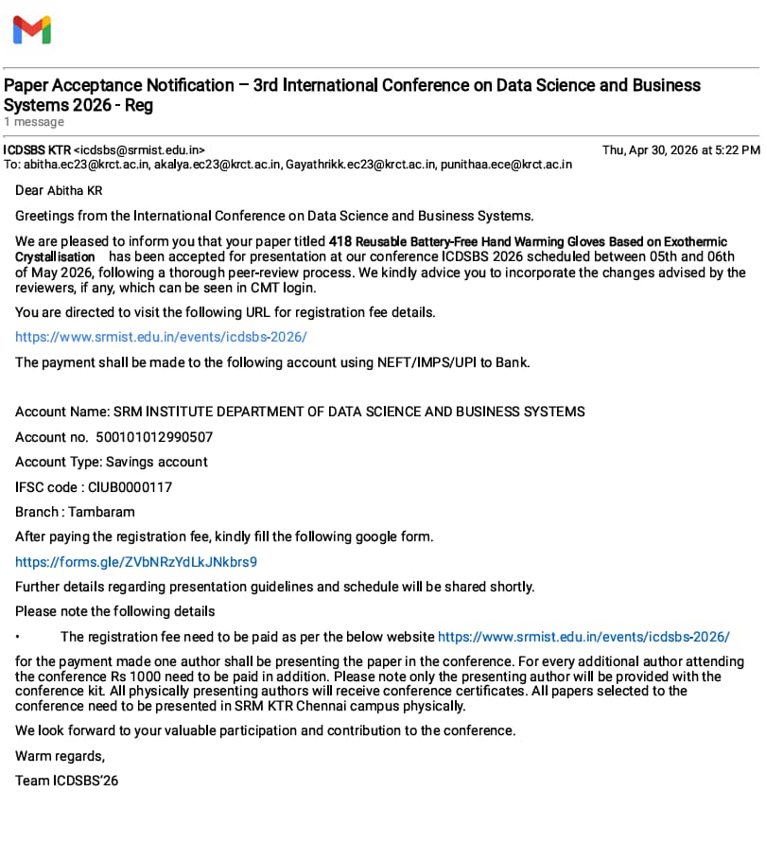
CONFERENCE ACCEPTANCE

Slide 18
